Slide 1

Linux Command Line Basics
MAN
is a form of software documentation usually found on a Unix or Unix-like operating system. The man command is used to format and display the man pages. Can be accessed without internet connection.
topics covered include computer programs (including library and system calls), formal standards and conventions, and even abstract concepts. A user may invoke a man page by issuing the man command.
by default, man typically uses a terminal pager program such as more or less to display its output.
a section, if provided, will direct man to look only in that section of the manual. Example: man 2 mount. The default action is to search in all of the available sections following a pre-defined order by default, unless overridden by the SECTION directive in /etc/manpath.config), and to show only the first page found, even if page exists in several sections.
man man – is a manual about how to use the manual
to search for a particular word within a man page, type “/word”. To quit from a man page, just type the “Q” key.
when you do not remember the name of Linux command and you need to search for it. For example, if you want to know how to change a file's permissions, you can search the man page descriptions for the word “permission” like this: man -k permission
If you look at the output of this command, you will find a line that looks something like: chmod (1) - change file access permissions. After typing man chmod will show you the chmod command's manual page!
Plan:
Man Pages
Info, Help and Whatis commands
Special Characters
The Linux Directory Layout
Busybox Comands
Shell and Environmental Variables
Resources
by Iryna Diudiuk

Slide 2
Linux Command Line Basics
INFO:
Some programs, particularly those released by the Free Software Foundation, use info pages as their main source of online documentation. Info pages are similar to man page, but instead of being displayed on one long scrolling screen, they are presented in shorter segments with links to other pieces of information. Info pages are accessed with the info command, or on some Linux distributions, pinfo (a nicer info browser).
Example: info df Loads the “df” info page
Help:
help on most Linux commands is typically built right into the commands themselves.
many commands have simple “help” screens that can be invoked with special command flags. These flags usually look like “-h” or “--help”.
e. g. grep --help
when typing -h or - -help you will see usage information and a list of options you can use with the command.
unlike man command, help does not use by default a terminal pager program such as more or less to display its output. So we need to type these commands, e. g. wget –help | less
WHATIS
this command shows a one-line summary of a command, taken from its man page. It’s a quick way of seeing what a command actually does.
by Iryna Diudiuk

Slide 3
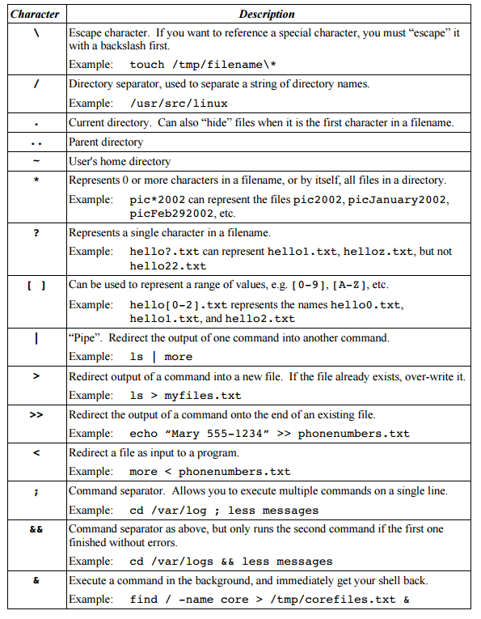
Linux Command Line Basics
<< Special Characters

Slide 4
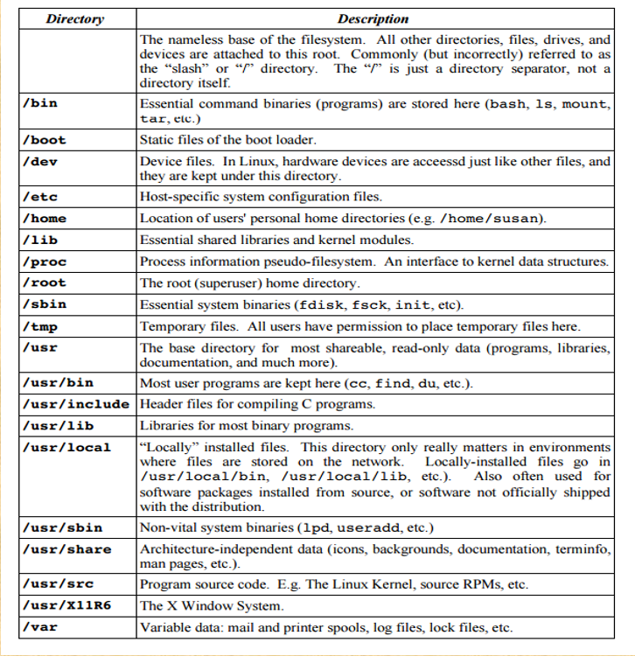
Linux Command Line Basics
<< The Linux Directory Layout

Slide 5
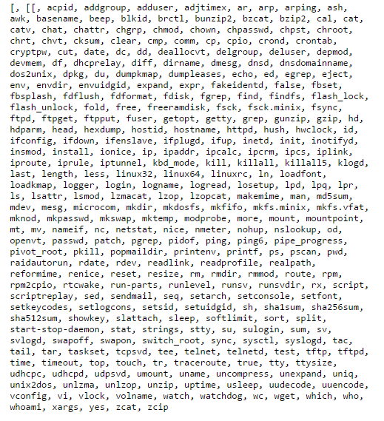
Linux Command Line Basics
Busybox:
BusyBox is software that provides several stripped-down Unix tools in a single executable file. It runs in a variety of POSIX environments such as Linux, Android, FreeBSD;
It was specifically created for embedded operating systems with very limited resources.
It replaces basic functions of more than 300 common commands.
It is released as free software under the terms of the GNU General Public;
Originally written by Bruce Perens in 1995 and declared complete for his intended usage in 1996, BusyBox originally aimed to put a complete bootable system on a single floppy disk that would serve both as a rescue disk and as an installer for the Debian distribution. Since that time, it has been extended to become the de facto standard core user space toolset for embedded Linux devices and Linux distribution installers. Since each Linux executable requires several kilobytes of overhead, having the BusyBox program combine over two hundred programs together often saves substantial disk space and system memory;
it allows code to be shared between multiple applications without requiring a library.
this technique is similar to what is provided by the crunchgen command in FreeBSD
Currently available commands:
by Iryna Diudiuk

Slide 6
Linux Command Line Basics
Environmental variables
are defined for the current shell and are inherited by any child shells or processes.
are used to pass information into processes that are spawned from the shell.
these types of variables are defined using all capital letters.
we can see a list of all of our environmental variables by using the env or printenv commands. Printenv helps request the values of individual variables.
env allows to modify the environment that programs run in by passing a set of variable definitions into a command
to turn shell variable into an environmental variable: export TEST_VAR
to see the result: print | grep TEST_VAR
to set environmental variable in one step: export NEW_VAR="Testing export“
to unset environmental variable: export -n TEST_VAR
Shell Variables
are variables that are contained exclusively within the shell in which they were set or defined. They are often used to keep track of ephemeral data, like the current working directory.
shell variable shouldn't be passed on to any child processes.
set command can be used to find shell variables
to create a shell variable: TEST_VAR=‘ Hello World! ‘
to see the result: set | grep TEST_VAR
to unset both shell and environmental variable: unset TEST_VAR
Login shell is a shell session that begins by authenticating the user. It will read configuration details from the /etc/profile file first. It will then look for the first login shell configuration file in the user's home directory to get user-specific configuration details. It reads the first file that it can find out of ~/.bash_profile, ~/.bash_login, and ~/.profile and does not read any further files.
Non-login shell session is started within already authenticated session. e.g. typing a the bash command from the terminal to start a bash child session. It will read /etc/bash.bashrc and then the user-specific ~/.bashrc file to build its environment.
Interactive shell session is a shell session that is attached to a terminal. It means that the commands are run with user-interaction from keyboard. E.g. the shell can prompt the user to enter input.
Non-interactive shell session is one is not attached to a terminal session. Non-interactive shells read the environmental variable called BASH_ENV and read the file specified to define the new environment.
by Iryna Diudiuk

Slide 7
Linux Command Line Basics
Resources:
http://vic.gedris.org/Manual-ShellIntro/1.2/ShellIntro.pdf
https://www.howtogeek.com/108890/how-to-get-help-with-a-command-from-the-linux-terminal-8-tricks-for-beginners-pros-alike/
https://unix.stackexchange.com/questions/19451/difference-between-help-info-and-man-command
https://www.digitalocean.com/community/tutorials/how-to-read-and-set-environmental-and-shell-variables-on-a-linux-vps
https://busybox.net/BusyBox.html
https://unix.stackexchange.com/questions/50665/what-is-the-difference-between-interactive-shells-login-shells-non-login-shell
by Iryna Diudiuk

